Slide 1

REACH
MISSION
Power commerce through world class communications.
VISION
The region to be at its economic and social best.

Slide 2
MISSION
Power commerce through world class communications.
VISION
The region to be at its economic and social best.

Slide 3
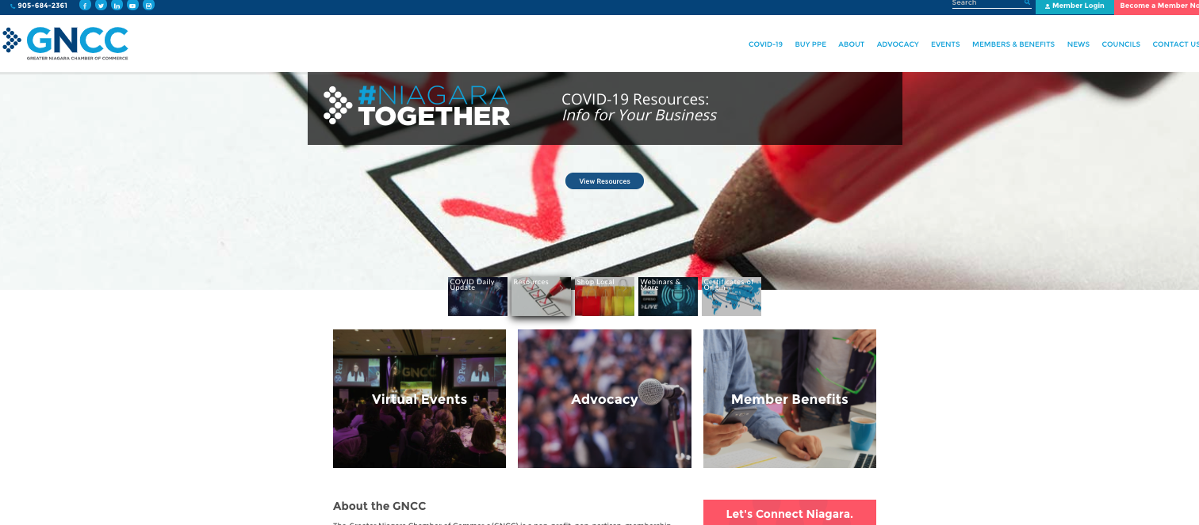

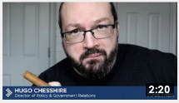

COMMUNICATE
New Products and Services

Slide 4






GROW
Online Events – Digital Pivot

Slide 5
GROW
Increased Following – Social Media
 | Dec 2019 | July 2020
Followers | 23,226 | 30,144
30%

Slide 6

GROW
Increased Engagement – Social Media
 | Social Interactions by Network Dec 2019 | Social Interactions by Network July 2020 | Growth
Facebook | 620 | 1683 | 171%
Instagram | 511 | 5779 | 1030%
LinkedIn | 198 | 991 | 400%
Twitter | 417 | 1263 | 138%
 | Social Clicks by Network Dec 2019 | Social Clicks by Network July 2020 | Growth
Facebook | 185 | 3048 | 1547%
LinkedIn | 55 | 508 | 823%
Twitter | 182 | 3125 | 1617%

Slide 7
GROW
Social Media Demographics – GNCC Handles
Instagram
Facebook
LinkedIn
Geography:
46% St. Catharines
15% Niagara Falls
4% Toronto
4% Welland
3% Niagara on the Lake
Age:
6% aged 18-24
32% aged 25-34
32% aged 35-44
18% aged 45-54
7% aged 55-64
Gender:
66% women
34% men
Geography:
31% St. Catharines
12% Niagara Falls
4% Welland
Age:
23% aged 25-34
26% aged 35-44
23% aged 45-54
15% aged 55-64
Gender
63% women
34% men
Geography:
65.7% Ontario
23% Toronto
Job Function:
13.17% Business Development
13% Sales
10% Operations
Industry:
9% Higher Education
6.7% Banking
5% Financial Services
Company size:
22% 1k-5k
16% 2-10
*Twitter removed demographic metrics from the platform in February.

Slide 8

GROW
Increased Engagement – Email
 | Open Rate Dec 2019 | Open Rate July 2020
Eblasts | 25% | 23%
Targeted | 51% | 48%
COVID-19 Daily Updates |  | 31%
 | Click Through Rate Dec 2019 | Click Through Rate July 2020
Eblasts | 6% | 8%
Targeted | 22% | 28%
COVID-19 Daily Updates |  | 15%
13% # of Subscribers

Slide 9
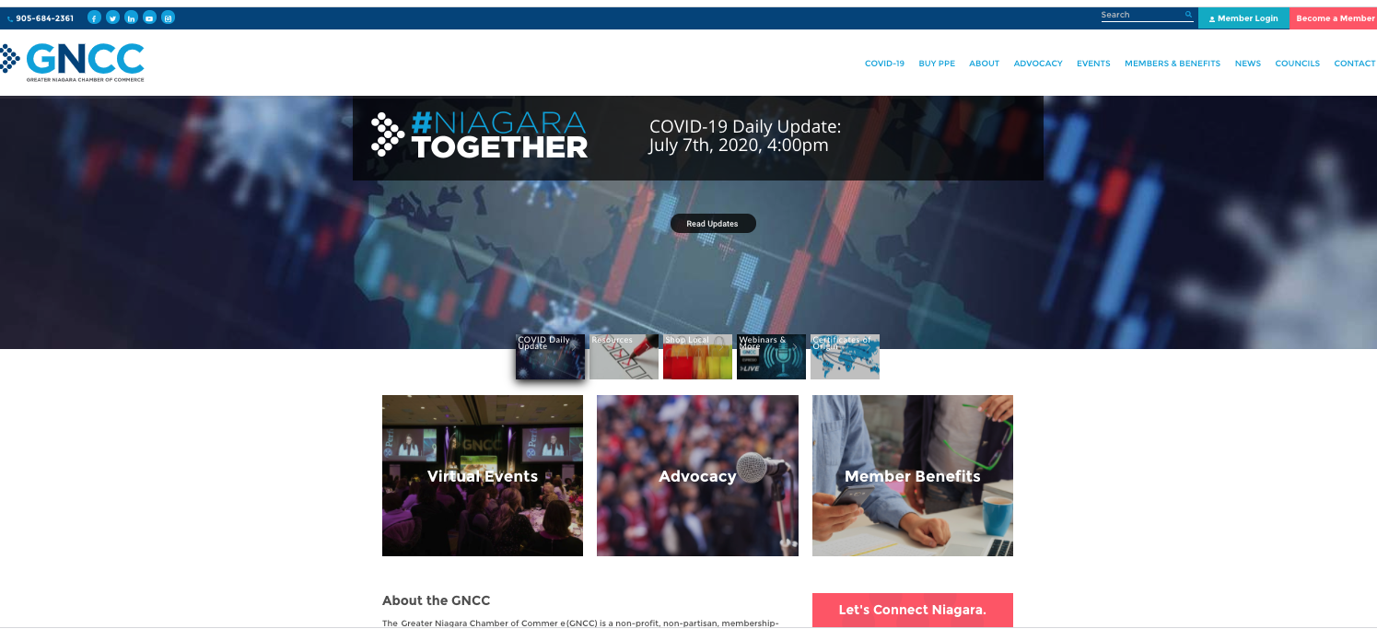
GROW
Increased Engagement – Website
 | Dec 2019 | July 2020 | Growth
Average Monthly Sessions | 7000 | 12,000 | 70%
Average Monthly Users | 5,333 | 9,500 | 78%
Sessions by Source | Dec 2019 | July 2020
Organic Search | 58% | 44%
Direct Traffic | 26% | 34%
Email Marketing | 9% | 11%
Referrals | 4% | 6%
Social Media | 2% | 5%
Total Traffic | 18,714 | 44,799
139%
Notes:
Shift from organic search

Slide 10
GROW
Website – Competitor’s Report
Website | Marketing Grade | Traffic Rank | Linking Domains | MozRank
calgarychamber.com | 44 | 1,111,060 | 1,198 | 3.7
hamiltonchamber.ca | 64 | 1,401,516 | 795 | 3.9
gncc.ca | 64 | 1,949,447 | 406 | 3.5
niagararealtor.ca | 67 | 2,783,708 | 365 | 3.4
niagaraonthelake.com | 44 | 4,060,793 | 3,441 | 5.3
grimsbychamber.com | 57 | 5,062,067 | 124 | 2.5
niagaraconstruction.org | 60 | 6,683,472 | 152 | 2.9
thevoice.ottawachamber.ca | 65 | 7,994,500 | 59 | 2.6
niagaraindustry.com | 57 | 10,518,007 | 88 | 2.7
niagarahomebuildersassociation.ca | 39 |  | 119 | 2.9
westlincolnchamber.com | 54 |  | 141 | 3
ncbotac.com | 57 |  | 21 | 1.2
wellandpelhamchamber.com | 59 |  | 370 | 1.9
pcwchamber.com | 59 |  | 370 | 1.9
forteriechamber.com | 60 |  | 370 | 1.9
niagarafallschamber.com | 63 |  | 370 | 1.9
lincolnchamber.ca | 66 |  | 73 | 2.6

Slide 11



GROW
Membership Retention

Slide 12




GROW
Broaden reach and services to transform into a business service organization

