Slide 1
National Economic Update
Dr. Trevin S. Stratton, Chief Economist

Slide 2
2019 Economic Growth

Slide 3
Drivers of Growth

Slide 4
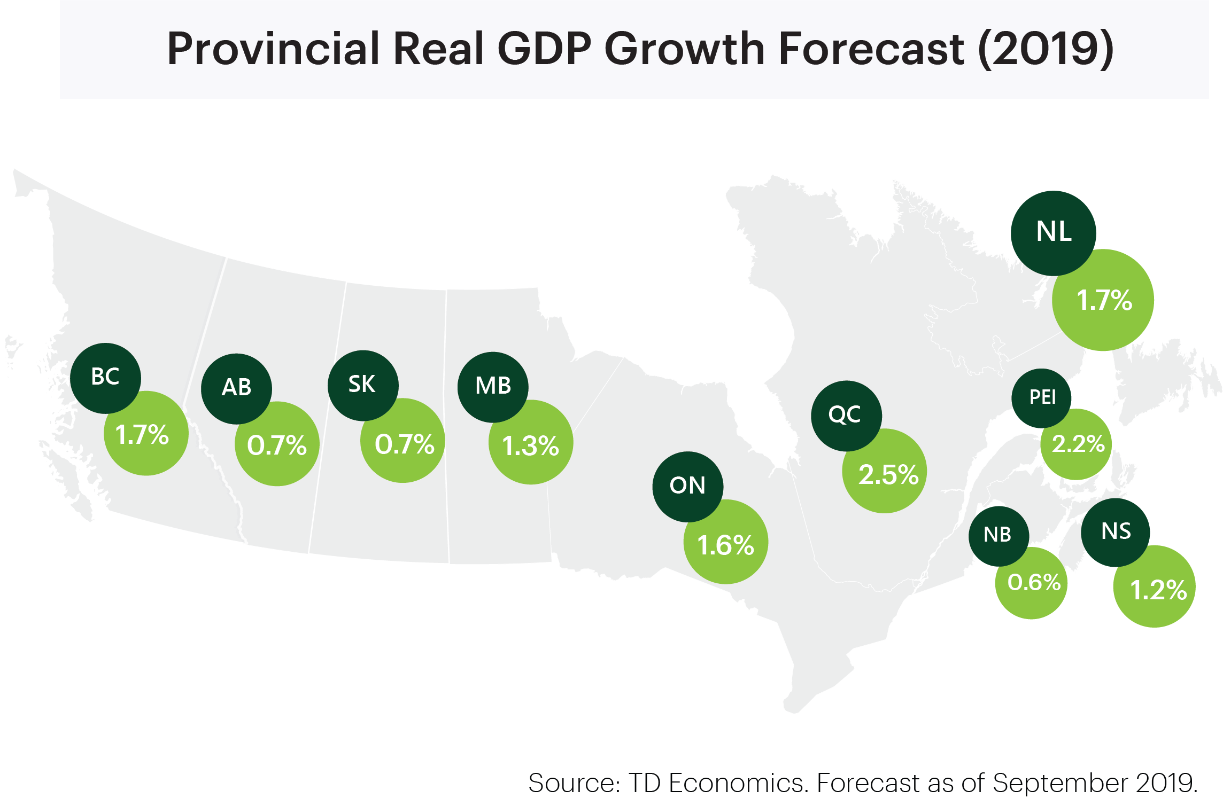
2019 Provincial Growth

Slide 5
Labour and Skills

Slide 6
Economic Projections

Slide 7
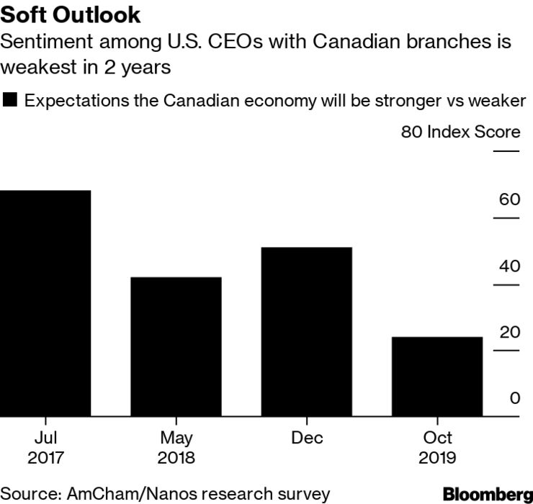
Business Confidence

Slide 8
Global Growth

